Slide 1

OneDelivery —
Agentic AI for CS
Architecting an end-to-end, production-grade agentic customer service platform on AWS
NUSISS Practice Module | Architecting AI Systems
NCS Team 16

Slide 2
Customer service scaling breaks on repetitive issues
The Problem
The Objective & Scope
Repetitive queries: Refund, logistics, and order issues overload teams.
Inefficiency: Manual resolution is slow, inconsistent, and hard to scale.
Autonomous CS pipeline: From intent → action → QA.
Microservices architecture: 12 services (7 domain + 5 AI agents).
Traceability: End-to-end audit trail for all decisions.

Slide 3
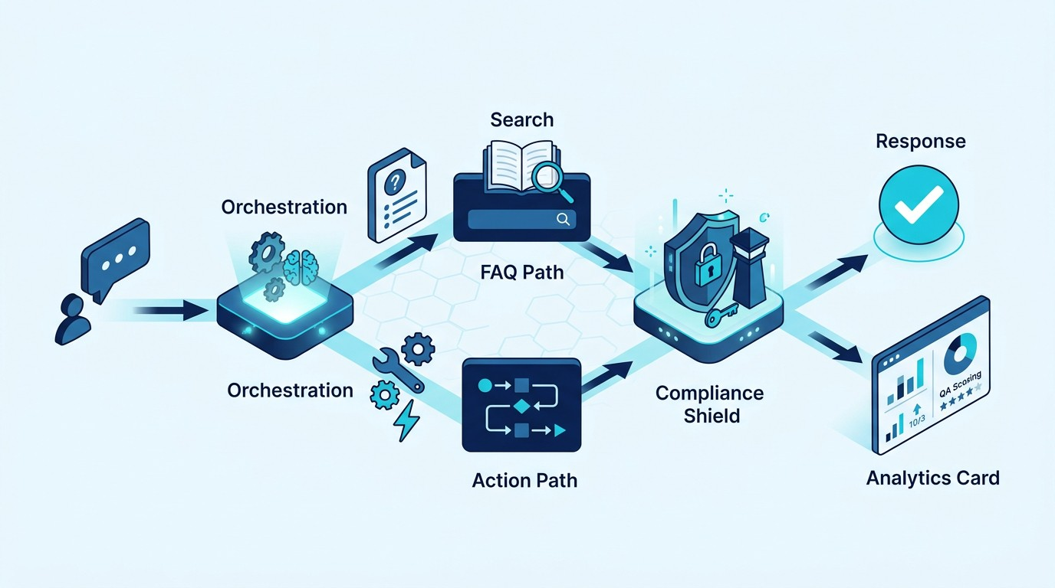
Deterministic orchestration, tool-based execution
1
Orchestrator Receives message (LangGraph)
2
Semantic Router Classifies intent (Action / FAQ / etc)
3
Execution Action Agent (SOPs) or FAQ Agent
4
Guardian Gate Validates compliance before execution
5
QA Agent Async post-session scoring

Slide 4
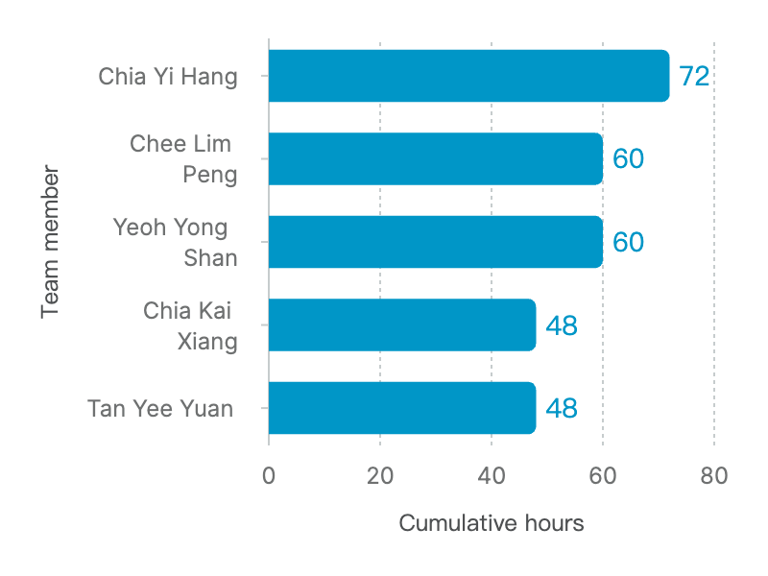
288 hours delivered across two milestones
288
TOTAL HOURS INVESTED
Milestone 1 (144 hrs): Repo & DevOps foundation, CI/CD pipeline, NestJS/ViteJS base.
Milestone 2 (144 hrs): Agent workflows, microservices scaffold, database schema planning.

Slide 5
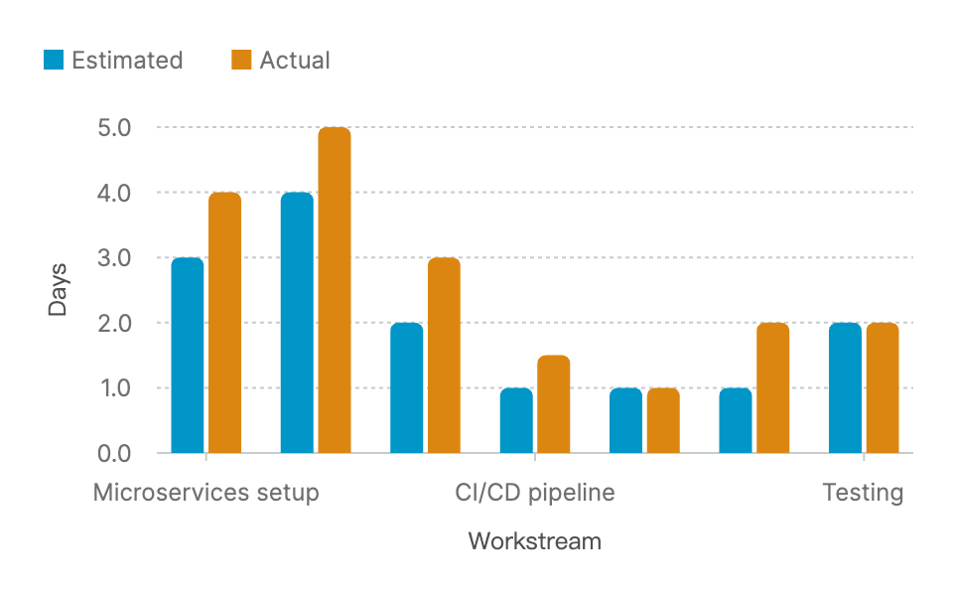
32% schedule overrun driven by orchestration & AWS
Key Overrun Drivers
LangGraph Complexity: State machine logic for orchestration required more iterations.
AWS Networking: VPC/ALB routing pivot and edge case handling.
ECS Exec: Debugging SSM permissions for container access.

Slide 6
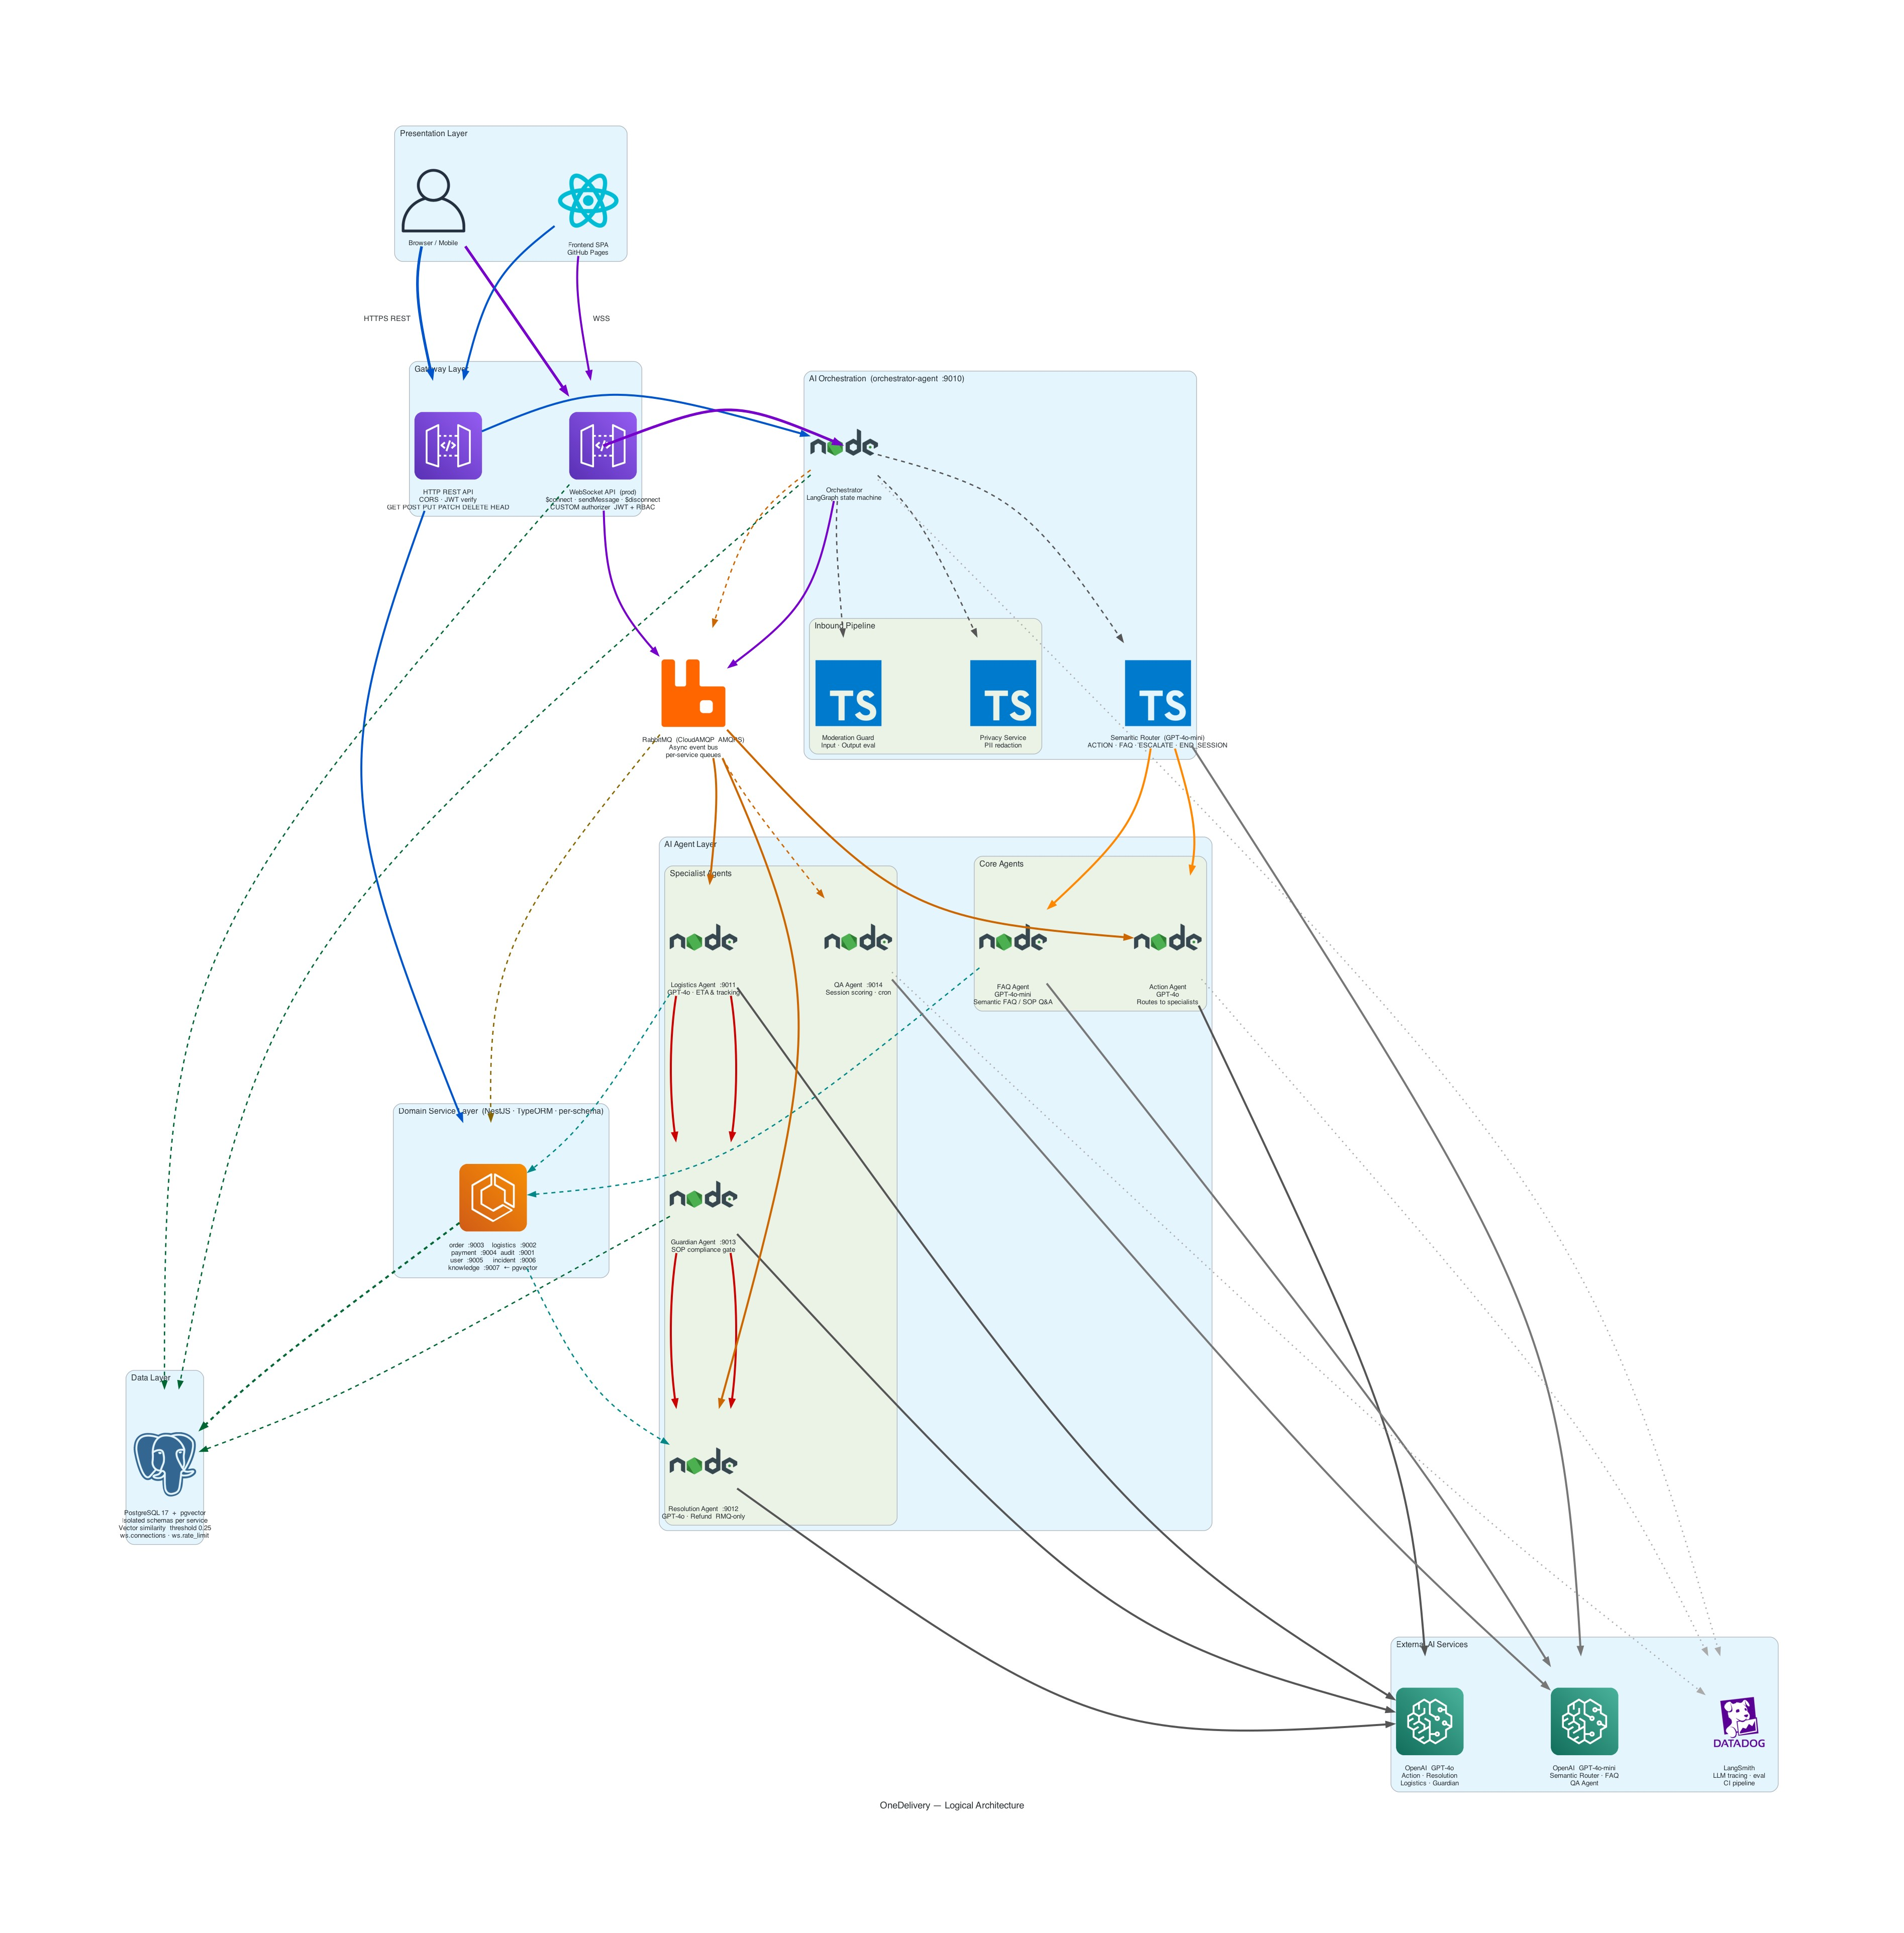
Layered design isolates concerns & enforces safe behavior
Presentation: React SPA (GitHub Pages)
Gateway: HTTP REST + WebSocket API with JWT/RBAC
AI Orchestration: Orchestrator + privacy + moderation + router
Agent Layer: Core agents + specialist agents
Domain Services: 7 NestJS microservices, per-service schema
Data: RabbitMQ + PostgreSQL 17 + pgvector
External AI: OpenAI models + LangSmith tracing

Slide 7
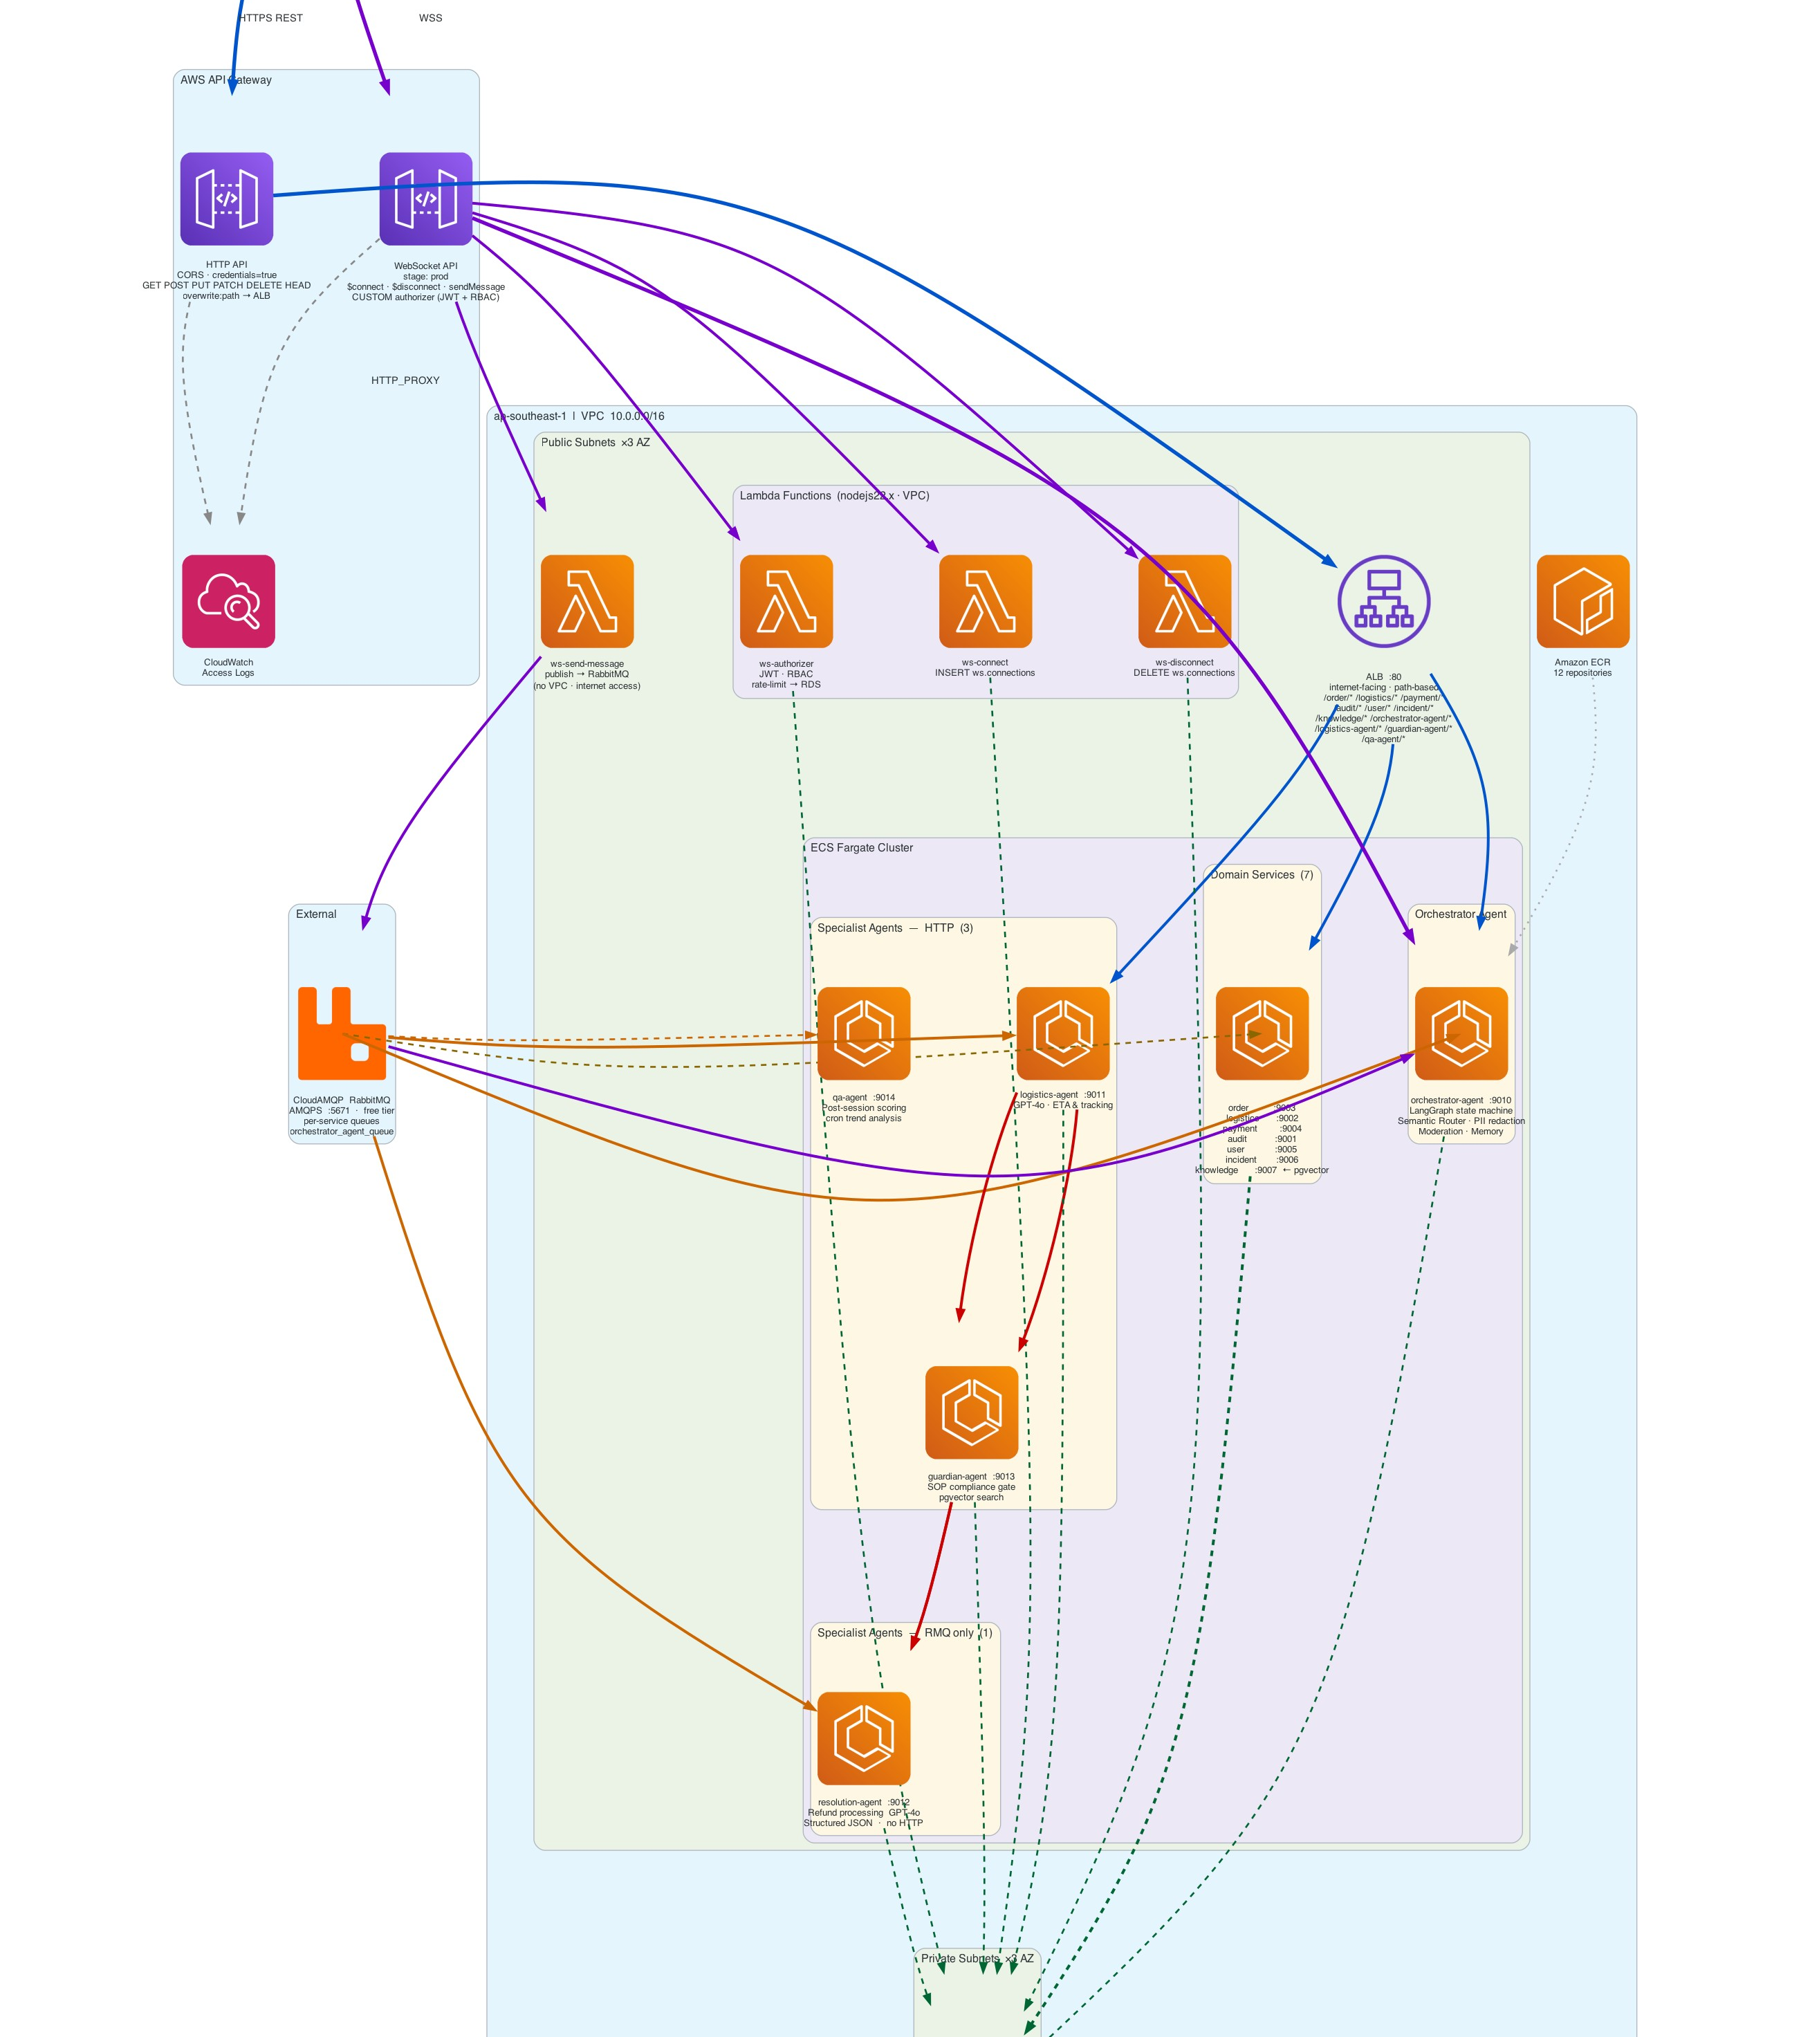
Production deployment on ECS Fargate with secure boundaries
Edge network: API Gateway (HTTP + WebSocket), Lambda authorizer, ALB path routing.
Compute layer: ECS Fargate cluster runs 12 services (agents + domain) inside VPC.
Data layer: RDS PostgreSQL in private subnets ensuring data isolation.
Security: Secrets injected via SSM Parameter Store at runtime.
Operations: Observability via CloudWatch; immutable image registry via Amazon ECR.

Slide 8
Standardized builds + traceable deploys across 12 services
Single Dockerfile Template
All 12 services use a unified template with build args for uniformity across the pipeline.
Traceable Image Tags
Docker images are tagged with their specific Git SHA for immutable, traceable deployments.
ECS Serverless Containers
Fargate execution means no EC2 management. ECS Exec enabled for secure debugging access.
Strategic Tech Stack
NestJS monorepo for shared code. RabbitMQ for async comms. pgvector for co-located semantic search.

Slide 9
Orchestrator coordinates the full pipeline with guardrails
Receive
Maintains session history in-memory by sessionId.
Privacy
PII redaction occurs before any external LLM call.
Moderation
Input validation + output evaluation gates.
Dispatch
Tools route to Logistics, Resolution, Escalate, or End.
Transitions
Deterministic flow: ROUTE → ACT/FAQ → GUARDIAN → RESPOND

Slide 10
Specialist agents execute domain workflows with strict policies
Logistics Agent
VS
Resolution Agent
Cancellation workflow executor. Validates & executes.
Refund processor. Computes math per line item.
Purpose
GPT-4o (temp 0) SOP injected at runtime.
GPT-4o-mini (temp 0) SOP injected at runtime.
Model
Stateless with bounded iterations. Guardian approval needed.
≤ $20: requires Guardian. > $20: auto-rejected.
Policy
Plain text: SUCCESS or REJECTED.
Structured JSON: With decision summary.
Output

Slide 11
Compliance and quality are independent control loops
Guardian Agent
QA Agent
Dual-mode: GATE (pre-execution) + VERIFY (post-loop).
Dual LLM: GPT-4o for decisions, GPT-4o-mini for injection scan.
Stateful: Tracks gatedActions + refundCount per session.
Policy: Fail-closed on GATE.
Post-session scoring: Incidents, sentiment, and trend analysis.
Tool access: log_incident, save_sentiment, fetch_trends.
Integration: Receives completed sessions fire-and-forget from orchestrator.

Slide 12
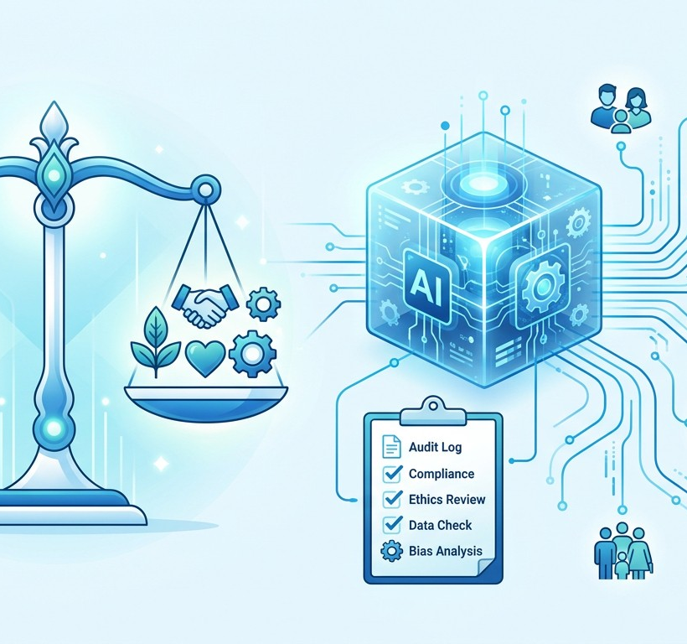
RAI built into the workflow, not bolted on
Explainability: Structured outputs + decision summaries returned by agents.
Transparency: LangSmith eval suite + audit trail for Guardian and Orchestrator transitions.
Privacy: In-process PII redaction (regex + NLP); no PII sent to LLM.
Human Oversight: Guardian gate + Escalate tool always available.
Accountability: sessionId/userId logs bound to all key decisions.

Slide 13
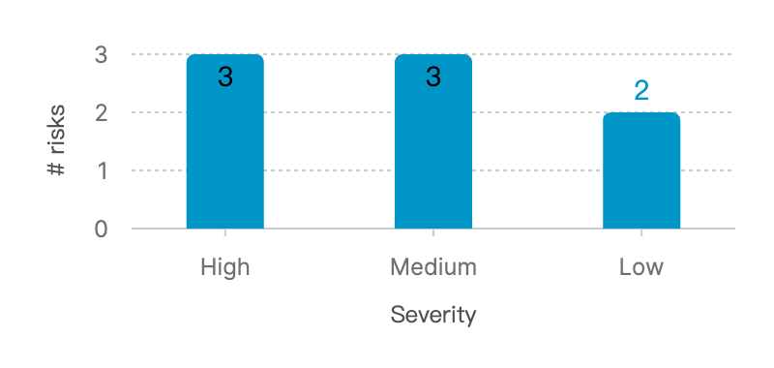
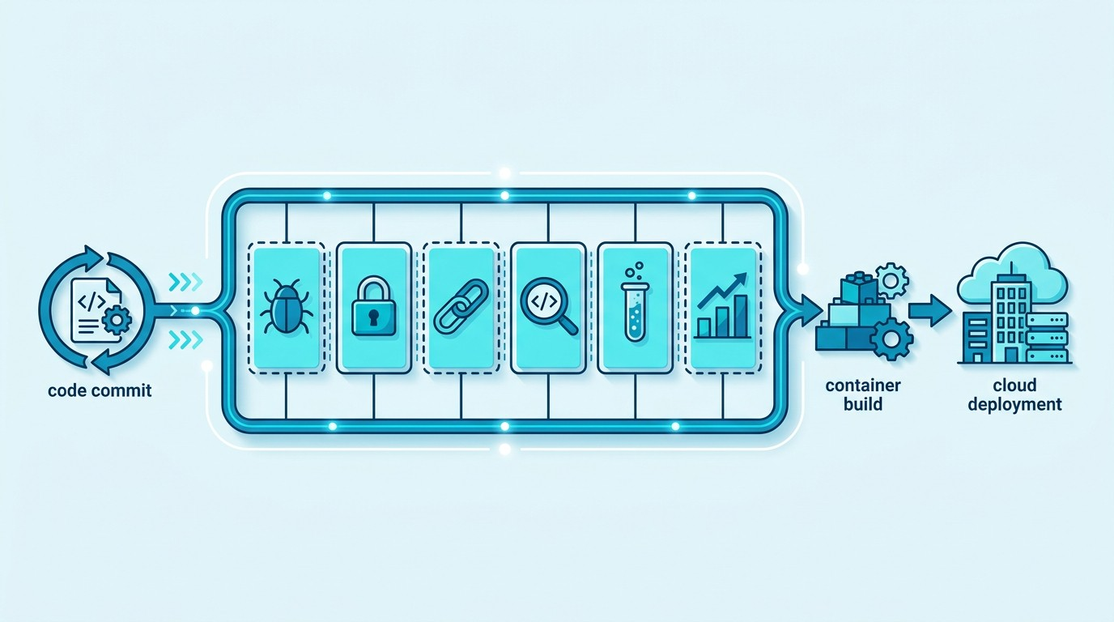
Threats are mapped to controls and enforced in CI/CD
Risk Register: Mitigations mapped for prompt injection, PII leakage, jailbreaks, and hallucination.
CI/CD Security: Trivy, OWASP dep-check, Semgrep, SonarCloud, ZAP, and LangSmith evals.
Stage 1: Runs 6 parallel security and evaluation jobs before allowing merge.

Slide 14
End-to-end autonomous CS flow
Demo: login → chat → routing → guardian approval → JSON → QA
Scenarios: happy path, blocked, FAQ via pgvector, PII redaction
Thank You

